Slide 1
Developing Online Master’s Programs for Teacher-Librarians: Current and Proposed Program at the University of the West Indies, Mona
Paulette Stewart, PhD
University of the West Indies, Mona
IASL 2014 CONFERENCE
Moscow, Russia

Slide 2
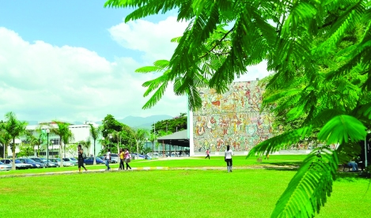
Introduction
Mona Campus is 66 yrs.
Serves 15 English-speaking countries in the Caribbean through three physical campuses:
Barbados (Cave Hill)
Jamaica (Mona)
Trinidad and Tobago (St. Augustine) and,
The Open Campus- offers multi-modal teaching and learning services across the Caribbean region.

Slide 3
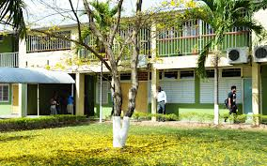
Introduction
The Department of Library and Information Studies (DLIS) is a part of the Faculty of Humanities and Education on the Mona campus.

Slide 4
previous master’s program for teacher librarians
The Master of Library and Information Studies (MLIS)
Graduates of a Bachelor’s degree in other disciplines.

Slide 5
previous Master’s Program for Teacher-Librarians
Requirements
Graduate of an approved university – GPA 2.75
Option 1
10 courses
Research paper of 10,000 – 15,000 words
Option 2
11 courses
Independent Study
Practicum - six weeks

Slide 6
Previous Master’s Program for Teacher-Librarians
Students writing the research paper have to attend at least four research seminars and make at least one presentation based on their research.

Slide 7
previous Master’s Program for Teacher-Librarians
Full-time - (Option 1) 2 years
Full-time – (Option 2) 1½ years
Part-time – (Option 1) 3 years
Part-time - (Option 2) 2½ years

Slide 8
Previous Master’s Program for Teacher-Librarians
Opportunity for overseas study
Through the International Students’ Office (ISO) students have been to the University of Toronto to pursue courses as part of their postgraduate program.
Practicum is done in overseas libraries upon the request of students

Slide 9
Previous Master’s Program for Teacher-Librarians
Course offerings for Teacher Librarians
Foundations of Libraries and Information Studies
Management of School Libraries and Learning Resource Centre.
Cataloguing and Classification
Contemporary Literature for Children and Young Adults

Slide 10
PREVIOUS PPROGRAM STRUCTURE
Semester 1 (Aug to Dec) Compulsory (5) Information Technology I Foundations of Libraries and Information Studies Management of Information Units Subject Analysis/Indexing in Information Retrieval Bibliography and Reference Methods/ Materials
Semester 2 (Jan to May) Compulsory (3) Subject Analysis and Indexing in Information Retrieval Research Methods in LIS Integrated Library Systems Electives (2) Mgmt. of University and Research Libraries Mgmt. of Special Libraries & Info Centres Mgmt. of Public Libraries Mgmt. of School Libraries and Learning Resource Centers Information Resources in Science and Technology Information Resources in the Social Sciences Contemporary Literature for Children and Young Adults
Semesters 3 and 4 (Aug to Dec, Jan to May) Option 1 Research Paper Option 2 Independent Study plus one additional elective course
Practicum (June to Aug) –6 weeks

Slide 11
proposed online master’s program for teacher-librarians
Objectives
The DLIS strategic objective is to :
“enhance learning effectiveness, which reflects the UWI, Mona Strategic Plan to provide “multiple and flexible paths for all prospective students to pursue tertiary education in their lifetime”

Slide 12
proposed online master’s program for teacher-librarians
Objectives cont’d.
Global trends in Library and Information Science education for multi-modal delivery;
Increased global and national competition for our students;
Continuous decrease in the numbers of students applying for this program.

Slide 13
Proposed Online Master’s Program for Teacher-Librarians
Evidence of demand for multi-modal delivery
Meetings held by the Head of DLIS:
Library and Information Association of Jamaica
College Library Network
Over 30 graduates of the Department at the St. Augustine Campus of UWI (Trinidad and Tobago)
Teacher –librarians in Jamaica (untrained)

Slide 14
Proposed online Master’s Program for Teacher-Librarians
Evidence of demand for multi-modal delivery
Meetings held by the Head of DLIS:
Director of the National Library and Information System Authority-Trinidad and Tobago
Announcement by the Ministry of Education in 2013 to suspend study leave to teachers (Thwaites, 2013).

Slide 15
Proposed Online Master’s Program for Teacher-Librarians
The Process
Staff attended workshops:
To get a greater understanding of how to implement and deliver a blended learning program.
To learn how to write course content for online delivery

Slide 16
PROPOSED Online Master’s Program for Teacher-Librarians
The Process
Training to use added features of Our Virtual Learning Environment (OurVLE).
“Moodle-based” platform used for online learning support at the University of the West Indies, Mona Campus.

Slide 17
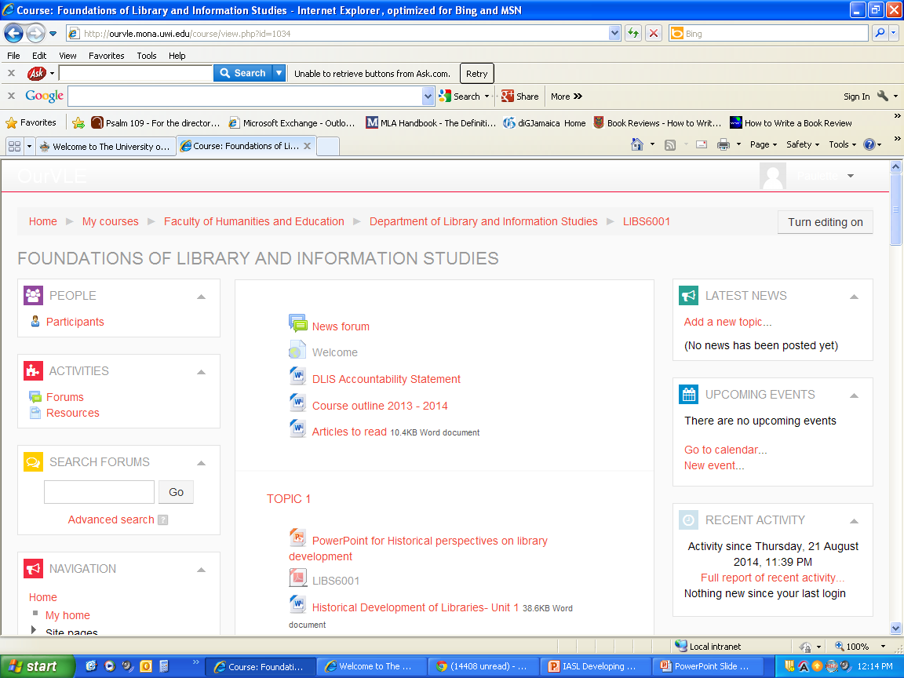

Slide 18
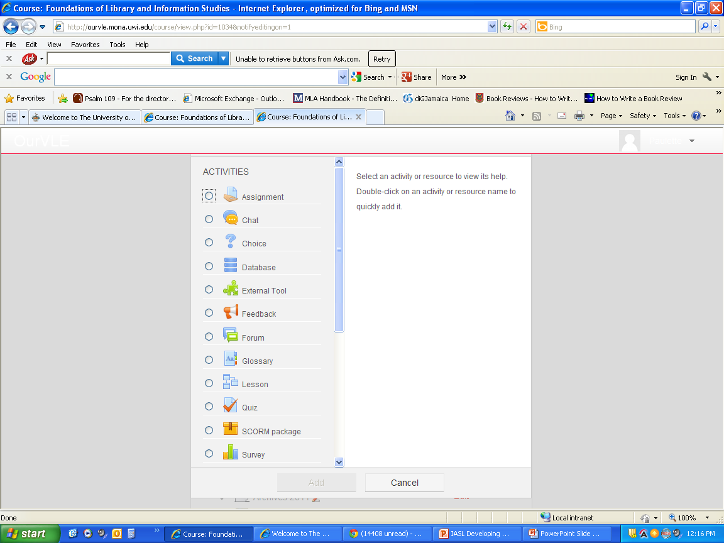

Slide 19
PROPOSED Online Master’s Program for Teacher-Librarians
Some OurVLE Features that support online Delivery
http://ourvle.mona.uwi.edu/course/view.php?id=1034
http://ourvle.mona.uwi.edu/course/view.php?id=1034&notifyeditingon=1

Slide 20
Blended learning program structure
Semester 1 (Aug to Dec)
Core (4) Information Technology I Foundations of LIS Mgt of Libraries and Information Units Subject Analysis/Indexing in Info Retrieval Bibliography & Reference Methods/ Materials Electives (1) Copyright Issues Affecting Caribbean LIS Metadata and Resources Discovery Trends and Issues in the Library Environment
Semester 2 (Jan to May) Core (1) Research Methods in LIS Electives (2) Information Literacy Instruction Info Resources in Science &Technology Info Resources in the Social Sciences Archives and Records Management Introduction to Digital Libraries
Summer Session 1 (Face-to-Face)
Core (3) Catalogue Creation and Use Subject Analysis/Indexing in Info Retrieval Integrated Library Systems Elective Basic Statistics (for students selecting research paper option)
Semesters 3 and 4 (Aug to Dec, Jan to May) Option 1 Research Paper (10,000 -15,000 words) Option 2 Independent Study plus one additional elective course
Summer Session 2 (Jun to Jul) Practicum (6 weeks)

Slide 21
Proposed Online Master’s Program for Teacher-Librarians
Major changes in the proposed program
The various library management courses were replaced by LIBS6106 Management of Libraries and Information Units.
Students will have the opportunity to do other courses without having to do extra credits.
Added elective courses
Archives and Records Management
Copyright Issues Affecting Caribbean LIS
Information Literacy Instruction
Digital libraries
Trends and Issues in the Library Environment

Slide 22
previous Master’s Program for Teacher-Librarians
Full-time - (Option 1) 2 ½ years (including 1 summer)
Full-time – (Option 2) 1½ years and 2
summer sessions
Part-time – (Option 1) 4 ½ years and a
summer session
Part-time - (Option 2) 4 years

Slide 23
Proposed Online Master’s Program for Teacher-Librarians
Adjusting course outlines and course contents
The existing course outlines were adjusted to reflect the change in delivery --- (blended learning)
Mode of instruction was modified to include online quizzes, graded and learning activities which are now embedded in the course contents
Virtual presentations by students

Slide 24
Proposed Online Master’s Program for Teacher-Librarians
Pedagogical approaches used for instruction
A blend of interactive and discovery approaches are used in this department.
The discovery approach - students to become self-directed and constructivist learners

Slide 25
Proposed Online Master’s Program for Teacher-Librarians
Pedagogical approaches used for instruction
Lecturers provide coaching or scaffolding to assist students in their discovery.
To be used in the multi-modal delivery as the learning management system can accommodate these types of teaching learning approach.

Slide 26
Proposed Online Master’s Program for Teacher-Librarians
Process for approval
Write proposal
Presentations to
Faculty of Humanities and Education Sub-committee
Faculty Board
Campus committee
Academic Board

Slide 27
Proposed Online Master’s Program for Teacher-Librarians
Supports and/or obstacles to development the development of the blended learning program
Campus Coordinator, School of Graduate Studies and Research - crucial information
Mona Information Technology Department in terms of further training DLIS staff to use the features of OurVLE.

Slide 28
Proposed Online Master’s Program for Teacher-Librarians
Supports and/or obstacles to development the development of the blended learning program
The Faculty of Humanities and Education has a technology room equipped for live streaming----
to conduct orientation sessions and to deliver some of the lectures.
Laboratory technicians will be on hand in the event that technological problems arise.

Slide 29
Proposed Online Master’s Program for Teacher-Librarians
Evaluation of past and proposed program
Programs are evaluated every five years - supervised by the Quality Assurance Department of the University of the West Indies.
The courses undergo continuous revision
Major changes require course to be presented at the sub-committee, Faculty Board and the Quality Assurance Committee for final approval.

Slide 30
Proposed Online Master’s Program for Teacher-Librarians
Evaluation of past and proposed programs
The multi-modal program is new -formative evaluation
A major summative evaluation will be conducted by staff before it is offered in the second year.
The course management system will also be evaluated to see if there is a need to upgrade any aspect of it.

Slide 31
Proposed Online Master’s Program for Teacher-Librarians
Impact evaluation
To be conducted at the end of the second academic year to:
Determine the impact that the program has on DLIS in terms of increase in the number of students
Benefits to students and,
Change in the profile of the Department,

Slide 32
Proposed Online Master’s Program for Teacher-Librarians
Obstacles
Program to be delivered across Jamaica only
Time frame to write course contents for online delivery

Slide 33
Proposed Online Master’s Program for Teacher-Librarians
Lessons learned and future plans
How to write an acceptable proposal for a multi-modal delivery program
How to organize the courses of an already planned program for multi-modal delivery.

Slide 34
Proposed Online Master’s Program for Teacher-Librarians
Future plans
Add new electives to the already existing program
Seek accreditation status from the American Library Association.
Continuous promotion of program.

